Slide 1
Blackboards
Inter-agent communication
Programming – Artificial Intelligence for Games
Last modified 24/05/16 by Conan Bourke

Slide 2

Contents
The problem of Agent communication
What is a Blackboard?
Why use Blackboards?
Simple Implementation

Slide 3

Agent Communication
In many video games artificial agents need to communicate with each other
Enemies need to coordinate their attacks
Enemies might need help from other enemies
NPCs might need to tell all other NPCs to stay a while and listen
Agents would then iterate over a list of all agents to communicate with them

Slide 4
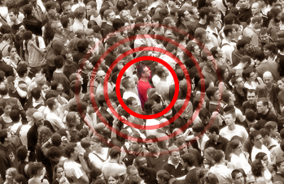

Agent Communication Issues
Now imagine a game where there a hundreds of agents, and more showing up all the time
Say our agents each need to communicate with each other, so that’s $O(N^{2})$ complexity
With just 100 agents that’s already 10000 iterations
We need a way to reduce this communication
One way is to centralise the communication so that agents don’t have to directly interact with each other

Slide 5

What is a Blackboard
Think of a blackboard in a classroom…
Someone has written a question on the board that everyone can see
Everyone who thinks they have an answer for it adds their response to the board
The teacher selects the most valid answer to the response

Slide 6

Definition of a Blackboard
The idea of a blackboard in artificial intelligence is similar
A blackboard exists that all agents can see
Agents don’t communicate directly with each other
Agents can post “questions” to the blackboard
Agents can see questions posted and respond as experts
An arbiter decides the correct or best response for the questions

Slide 7
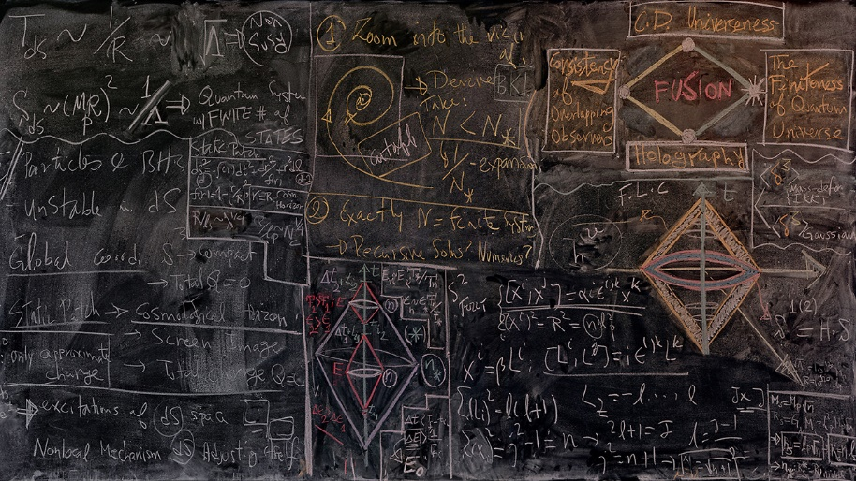
Blackboards
A blackboard is just a system that all agents can access
Agents don’t have to be NPCs, an agent could be a game system
The blackboard allows messages to be posted
Messages can be as simple as a key-value pair, the key being the type of message or question and the value being the message’s data or details
Experts then respond to the posted messages

Slide 8

Experts and Arbiters
Expert is just the term given to entities that respond to the posted questions
The believe they are an expert on the question and have the best response
Arbiter is the entity or systems that makes the decision on which response was the best
Take the following example:
An A.I. enemy in a shooter game is about to charge through a door but needs someone to come with it
The enemy posts to the blackboard for help
Nearby enemies all respond to the message that they want to come and can come since they are “experts”
Injured enemies don’t respond
The enemy acts as the “arbiter” and chooses the closest teammate to come with it

Slide 9

Simple Blackboards
Blackboards don’t always have to be implemented with arbiters
Blackboards can simply be a form of data storage for other agents / systems to see and access
An agent could have its own blackboard and post useful information for others to see
Agents no longer need to know about the underlying class of the owner of the blackboard, just how to communicate with a blackboard
For example, an agent could post and update its position within a blackboard and other agents can communicate with the blackboard and not care about the agent being a Car, or Monster, or Ape Man, or Door, just that it has a position

Slide 10

Why use a Blackboard?
If not apparent yet, Blackboards have many advantages
To centralise data
Blackboards are a nice way to centralise data and remove the need for extra knowledge about where that data comes from
Without blackboards, you often have to go through a number of steps to query information that’s stored in various different classes
To cache calculations
Some data has to be calculated, which can be a pain to do repeatedly or simply expensive for performance
Therefore, it’s frequently desirable to cache the calculated value for use later so it doesn’t have to be repeatedly recalculated
As a scratchpad area
Some data you may need to use that doesn’t have any other obvious home
To communicate between agents
Multiple agents can all have access to the same blackboard and use it to make decisions or pass information between each other

Slide 11

Blackboard Implementation
Simple blackboards can be easily implemented as a data container storing key-value pairs
The key is the message / question type or identifier
The value is the contents of the message or question
The key could be a name, or ideally a simple integer identifier
The value needs to be able to represent various data types depending on the message type

Slide 12
Blackboard Implementation
Since our blackboard needs to be able to store data of any type we could make use of a union of various base types
We create an enum for all the types we want to support and a union for the actual value
Our blackboard values would then be a structure that contains the type and the union
enum BlackboardItemType:
type_float,
type_int,
type_char,
type_bool, type_pointer
struct BlackBoardItem:
BlackboardItemType type;
union value:
float floatValue;
int intValue;
char charValue;
bool boolValue;
void* pointerValue;

Slide 13
Blackboard Implementation
The Blackboard itself can be a simple class that stores items based on an identifier
We can query if identifiers exist
We can access the data stored at certain identifiers
Agents or game systems would then have a Blackboard that has public visibility to other agents and systems
class BlackBoard:
// returns true if id exists
def getEntry(id, item)
def setEntry(id, item)
def hasEntry(id)
// contains key-value pairs
entries

Slide 14
Blackboard Implementation
This simple data storage container can then be extended to add various processing steps
Arbiters and experts for example
A simple series of steps could be
Agents post messages to a central blackboard
Agents post potential responses to messages they can see as experts
Arbiters decide best responses
Chosen responses are executed
A blackboard question entry might have a value that stores expert responses and each expert agent adds to the list
The entry then has an arbiter function that processes the responses and executes the best expert result

Slide 15
Example Expert / Arbiter Implementation
def arbiter()
bestExpert = None
bestResponse = 0
for expert in experts:
response = expert.getResponse()
if response > bestResponse
bestResponse = response
bestExpert = expert
if bestExpert:
bestExpert.execute()
class Expert:
def getResponse()
def execute()
class BlackboardQuestion:
experts
def arbiter()

Slide 16
Summary
Agents communicating directly with other agents can cause issues
Blackboards are a way to reduce communication between agents
Blackboards can be simple data storage or complex expert / arbiter systems

Slide 17
References
Millington, I, Funge, J, 2009, Artificial Intelligence for Games, 2nd Edition, CRC Press

